Slide 1
MoM in 2D analysis for scattering by a conducting cylinder
Project 3, Yifan Wang

Slide 2
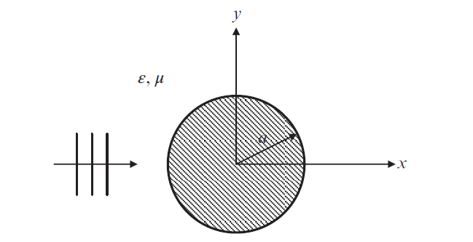
Problem setup
Top View
Incident plane wave -> two polarizations (TM with Ez, TE with Hz)
Vacuum outside the conducting infinitely long cylinder -> ε = ε₀, μ = μ₀

Slide 3



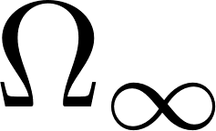
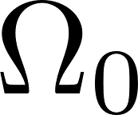
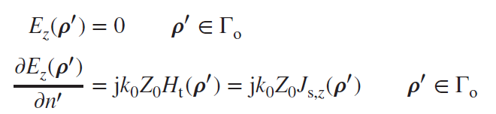

PDE vs Integral Equation for TM polarization
Helmholtz equation with source of the plane wave J_{i,z}
electric-field integral equation (EFIE), using boundary conditions
boundary conditions

Slide 4

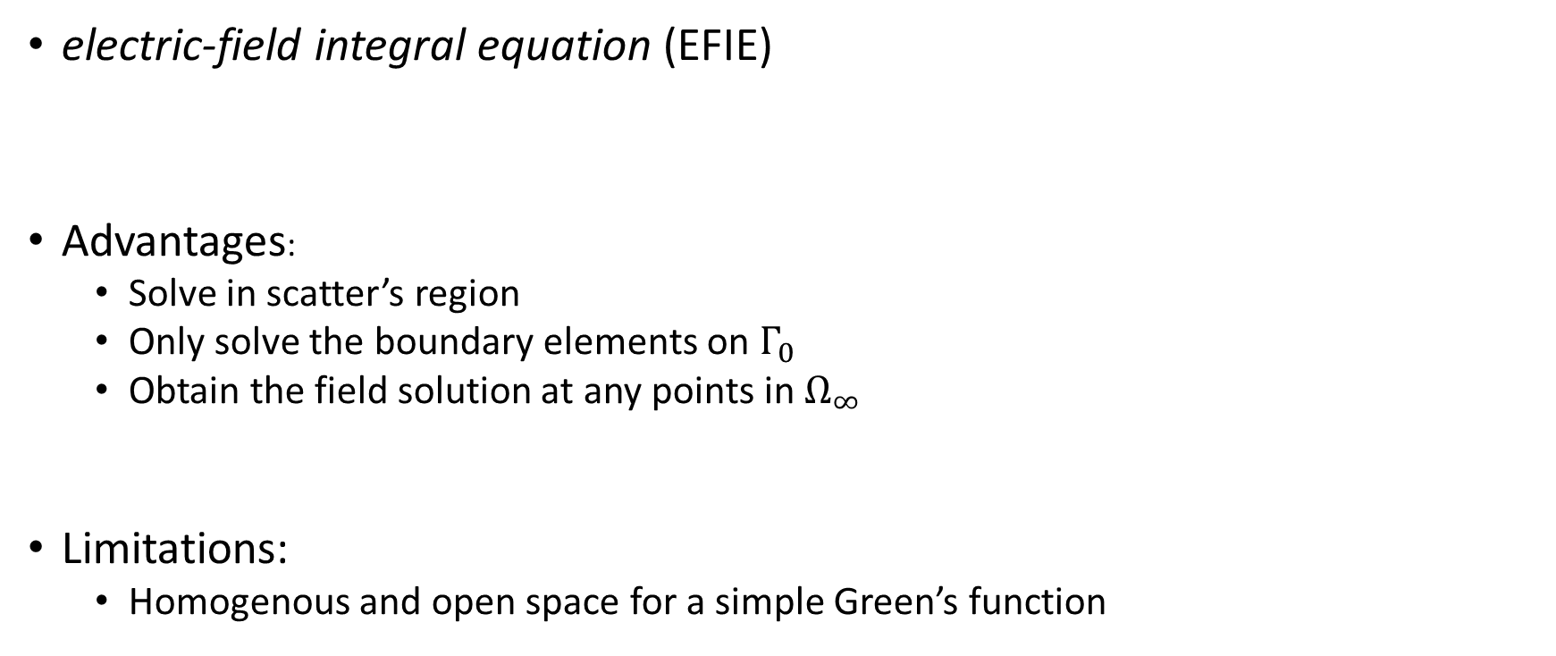
PDE vs Integral Equation for TM polarization
electric-field integral equation (EFIE)
Advantages:
Solve in scatter’s region
Only solve the boundary elements on $Γ_{0}$
Obtain the field solution at any points in $Ω_{∞}$
Limitations:
Homogenous and open space for a simple Green’s function

Slide 5

Discretization
N uniform boundary elements
Small segments
Assume the surface current density over each segment is a constant

Slide 6
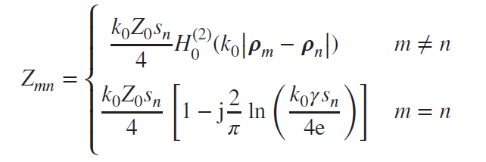
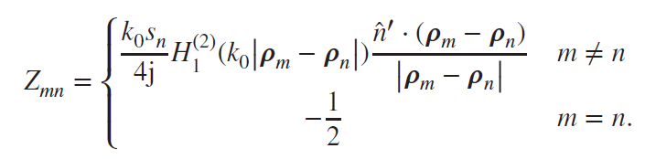
Z matrix construction
Using midpoint integration
For TM
For TE

Slide 7
r = λ; N = 500
For TM
For TE

